Slide 1
About WebRTC
Presentation

Slide 2
Prepared By
Md. Musarrat Hossain Chowdhury

Slide 3
TABLE OF CONTENTS
1. Introduction
2 . What is web RTC ?
3. What is a signalling server?
4.WebRTC APIs
5.GetUserMedia ()
6.RTCPeerConnection()
7.RTC DataChannel()
8.How Connection is established?
9. ICE(Interective Connectivity Establishment)
10.How to scale for millions of users
11. Uses of WebRTC
12. Web RTC alternatives
13 . Advantages and disadvantages of Web RTC
14. Conclusion

Slide 4
Introduction

Slide 5
What is Web RTC
WebRTC (Web Real-Time Communication) is a new web technology which allows browser and mobile applications with functionalities such as audio/video calling, chat, P2P (peer-to-peer) file sharing and all that without any additional third-party software or plugins.
It was published as an open source technology by Google in May 2011 and includes fundamental components for real-time communication on the web.
WebRTC is also highly secure, as it uses end-to-end encryption to protect data and ensures that only the authorized parties can access it. Additionally, WebRTC is open-source, which means that anyone can access its source code and contribute to its development.
WebRTC is a powerful and versatile technology that has revolutionized real-time communication on the web, and its adoption continues to grow rapidly as more developers discover its capabilities.

Slide 6
WebRTC Architecture

Slide 7
What is a signaling server?
Signalling is the process of setting up, controlling and terminating a communication session between the clients.
To communicate between 2 end point major 3 process needs to happen:
Session control information
Exchange IP address and port related information
Exchange codes and media type of the end user.
These configuration (metadata) are exchange via (Session Description Protocol).
So there should be a server to exchange the user data initially to setup WebRTC connection.
After the signaling process, all the media and data will be exchanges via RTC peerconnection od WebRTC.

Slide 8
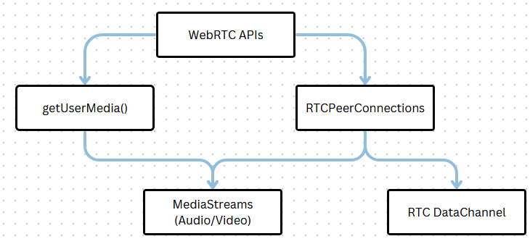
WebRTC APIs
It is important to know that WebRTC is not just a single API , but it is a collection of APIs. And protocols defined by various working groups such as W3C and IETF (Internet Engineering Task Force).
Fig: 1

Slide 9
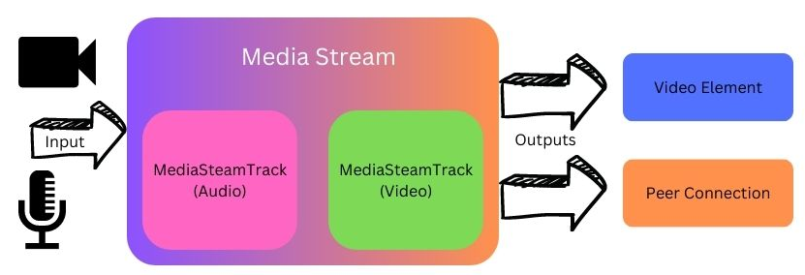
GetUserMedia ()
Provide access to multimedia stream (video, audio or both) from local devices.
Two main components in the MediaStream API are the MediaStream track and MediaStream interface.
Fig:2
MediaStream track represents a type of media that have been obtained from the input source.
The output can be forwarded as video element or PeerConnection.

Slide 10
RTCPeerConnection()
The RTCPeerConnection API represents a WebRTC connection between the local computer and remote peer.
Core part of the WebRTC connection.
It provides methods- connect to a remote peer, maintain and monitor the connection , and close the connection.
This API is responsible for managing the full life cycle of each peer-to-peer connection.

Slide 11
RTC DataChannel()
RTCDataChannel API enables exchange of arbitrary data between two peers.
RTCDataChannel can be configured to provide reliable or unreliable delivery of messages.
RTCDataChannel can be configured to provide in-order or out-of-order delivery of messages.
Reliable and in-order delivery is similar to TCP(Transmission Control Protocol).
Unreliable and out-of-order delivery is similar to UDP( User Diagram Protocol).

Slide 12
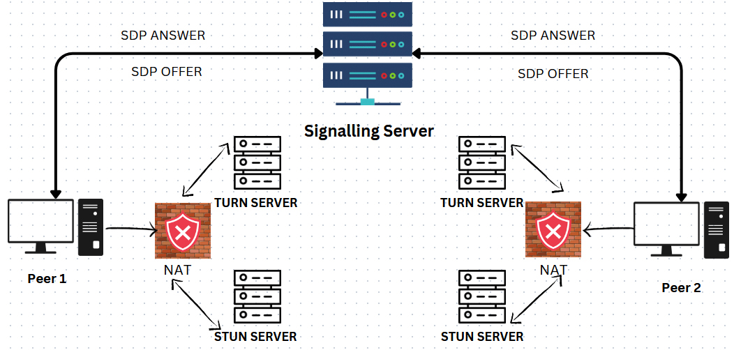
How Connection is established?

Slide 13

Developers need to pass ICE server URLs to the peer connection for establishing a connection between two peers.
ICE (Interactive Connectivity Establishment) finds the best path to connect two peers using STUN and TURN servers.
STUN (Session Traversal Utilities for NAT) server is used by ICE to determine the external address of a peer.
If STUN server fails, ICE routes the traffic through a TURN (Traversal Using Relays around NAT) server.
Every TURN server supports STUN, which means it has added relaying functionality built-in.

Slide 14
ICE(Interective Connectivity Establishment)
The internet addressing system is still using IPV4 (Internet Protocol Version 4) and because of that , most of our devices are behind ine or more layers of NAT (Network Address Transmission) NAT is a mechanism of mapping private address to the public addresses to the public addresses changing address information within IP protocols while it is in transmit through the device for routing.
WebRTC technology developers can use ICE which simplifies the complexity of the internet addressing system.
After session description set, ICE agent automatically begains to find all the possible candidate IP, port for local peer.
ICE agent queries the operating system for local IP addresses.
ICE agent queries an external STUN server (id configured) to retrieve the public IP and port.
If configured, ICE agent add the TURN server as a last resort candidate.

Slide 15
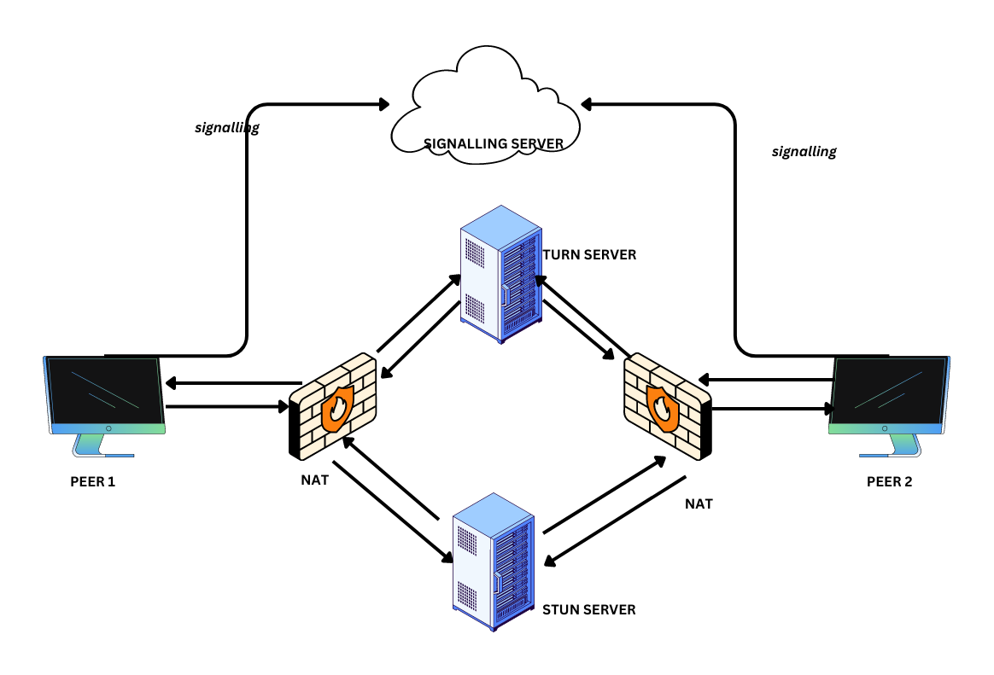
ICE(Interective Connectivity Establishment)

Slide 16
How to scale?
To Scale the project for millions of users these modifications can be done :
Use adaptive bitrate streaming,
Implementing efficient media codecs , reducing the size of the media streams, minimizing the use of server resources.
Use a signaling server with horizontal scaling
Use a media server for media handling
Optimize media handling
Use a distributed database
Optimize client performance

Slide 17
Uses of Web RTC
WebRTC can be used in a variety to enable real-time communication and collaboration features. Here are some common uses of WebRTC :
Video conferencing:. Users can join a virtual meeting room and communicate with each other in real-time, with support for high-quality audio and video streams.
Live streaming :Users can broadcast live events, concerts, or webinars, and viewers can join the stream and interact with each other in real-time.
Gaming : Users can play multiplayer games with each other in real-time, with support for low latency and high-quality audio and video streams.
E-learning : Users can attend virtual classes, seminars, or workshops, and interact with each other and the instructor in real-time.
Customer support : Users can join a virtual helpdesk and communicate with customer support agents in real-time, with support for audio, video, and data exchange.
Remote collaboration : Users can collaborate on projects, documents, or code, and communicate with each other in real-time using audio, video, and data exchange.

Slide 18
Advantages and disadvantages of Web RTC

Slide 19
Web RTC alternatives

Slide 20
Conclusion

